Slide 1
Football 2020-21

Slide 2
BACKGROUND
A high-performing, comprehensive high school serving approximately 3,000 diverse students from more than 110 zip codes throughout the Los Angeles area.
A charter school since 2003, Palisades Charter High School is one of the first high schools in the Los Angeles Unified School District to achieve independent charter school status.
Independent status allows the school stakeholders and governing board to make important decisions regarding instruction, budget allocations, and policy; school governed by a Board of Trustees.
PCHS is a California Gold Ribbon School, a California Distinguished High School, as well as being recognized by Newsweek, U.S. News and World Report, and LA Magazine.
PCHS offers a full range of competitive sports, arts, and other activities.
Athletics offers 16 different sports, 20 sports teams and 42 participation levels. Football participates in Division I of the City’s Western League.

Slide 3
BACKGROUND
California Nonprofit Public Benefit Corporation formed under section 501(c)(3) of the Internal Revenue Code. Founded in 2011.
Vision: support and aid the Palisades Charter High School football program while enriching the educational and athletic experience of the football program’s student athletes.
Function: Implement fundraising activities supporting support academic and athletic excellence, the teams’ commitment to quality, values-based philosophies, and the ideals of pursuing victory with honor.
Palisades Charter High School provides less than 10% of football program’s budget.
State of California does not provide the financial resources necessary for football program to thrive on its own.
Continuing challenge to meet numerous and escalating needs of football program to assure our players are safe, competitive, and academically eligible.
Pali Quarterback Club must fundraise to meet football programs’ total budget.

Slide 4
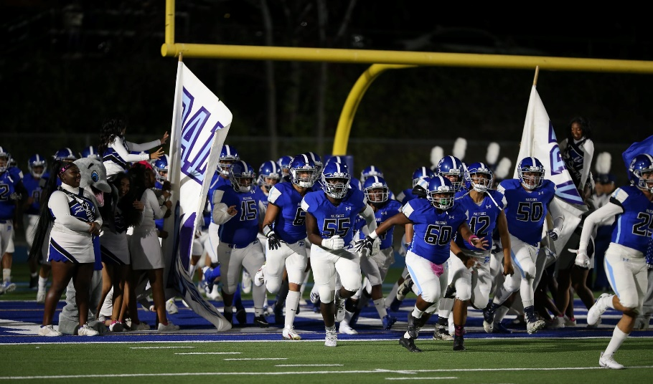
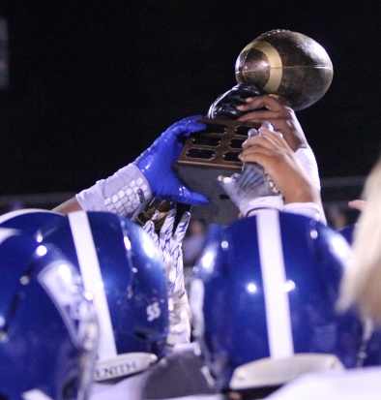
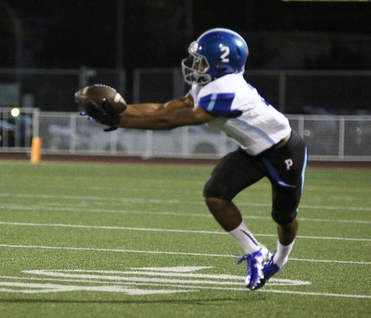
PALI PRIDE! MAKE A LASTING IMPACT ON PALISADES FOOTBALL!
Heritage: Founded in 1961, Pacific Palisades Charter High School has provided superior education and developed scholar athletes and future leaders, making it one of the premier public high schools in the country.
Legacy: Throughout the years, Palisades Football has thrived.
Under the leadership of Head Coach Tim Hyde since 2013, the Dolphins have played in City playoffs for the last 4 years and in 2015, the Dolphins became Western League Champions for the first time since 1987 – more than 30 years ago. Repeated in 2019.
Last year, Dolphins won the Western League and were placed in the Open Division playoffs. Lost to Banning (Wilmington) in playoffs.

Slide 5
WHY ARE WE ASKING FOR YOUR SUPPORT?
Pali Football is one of the consistently top public student-athletic programs in LAUSD, but minimal funding does not match our basic needs or the trajectory of program or team’s performance.
Palisades High School funds less than 10% of the football program’s annual total budget. No funding comes from the district or the state.
Every year, the Pali Quarterback Club must fundraise to meet the rest of the program’s annual costs.
$858 is the average amount spent directly on each player each season by the Pali Quarterback Club
The Pali Quarterback Club funds items such as helmets, shoulder pads, training equipment, game equipment, game uniforms, practice uniforms, game day polos, work out gear / spirit packs, hydration beverages during practices/games, pre-game meals, coach stipends and game filming.
The impact of COVID-19 on our program will result in both a decrease in funding and fundraising opportunities, plus an increase in expenses to keep our players and coaches safe.

Slide 6
DONATION LEVELS AND BENEFITS
FROSH – SOPH
$2,500
JV
$5,000
VARSITY
$10,000
ALL LEAGUE
$15,000
HALL OF FAME
$25,000
Program Advertising
Banner Advertising
Team Hat & T-Shirt
Program Advertising
Banner Advertising
Team Hat & T-Shirt
Sideline Seats for two at a home game
Program Advertising 2 years
Banner Advertising 2 years
Team Hat, T-Shirt, and Hoodie
Sideline Seats for 2 at all home games
Program Advertising 2 years
Banner Advertising 2 years
Full Team Swag: Hat, T –Shirt, Car Sticker, Hoodie and Jersey
Sideline Seats for 2 at all home games
VIP Parking for 1 car at all home games
Program Advertising 5 years
Banner Advertising 5 years
Full Team Swag : T –Shirt, Hoodie, Hat, Stadium Seat, Beanie, Team Jersey & Official Palisades Letterman’s Jacket
Sideline Seats for 2 at all home games
VIP Parking for 1 car at all home games
Contacts: Heather Bell, heather.bell@theagencyre.com; Ken Ehrlich, kehrlich@elkinskalt.com

Slide 7
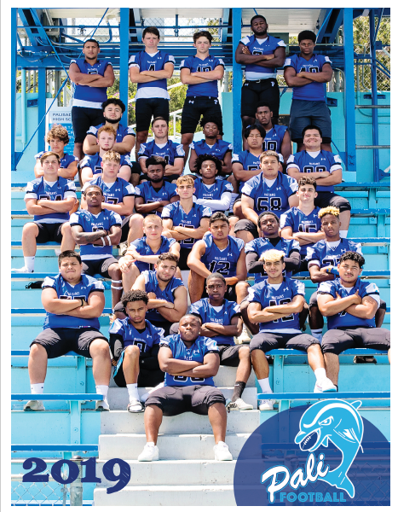
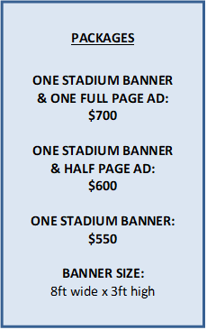
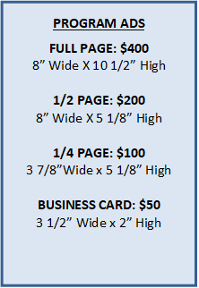
PALI FOOTBALL STADIUM BANNER & PROGRAM SUPPORT
Opportunities exist to purchase a banner that will hang at the stadium for the entire season, and to buy an ad in the official Game Program.
Full Color 56-page program

Slide 8
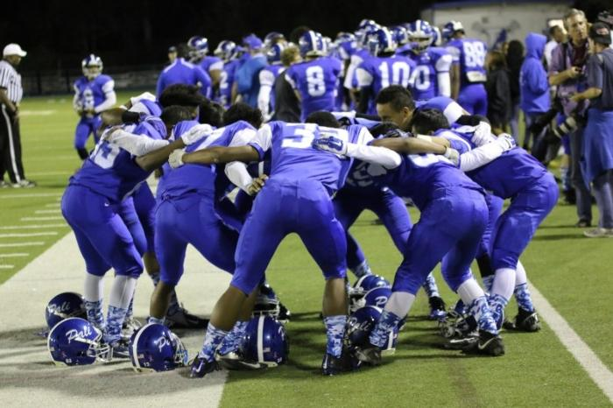
PALI FOOTBALL BASICS
GAME SCHEDULE: 2020 Game Schedule on next page and see website: www.palifootball.org
HOW TO REACH US:
Palisades Quarterback Club
Email: paliqbclub@gmail.com
Website: www.PaliFootball.org
​​​​​​​Facebook.com/paliquarterbackclub
Instagram.com/paliqbclub
HOW TO REACH TEAM:
Head Coach TimHyde: thyde@palihigh.org
JV Head Coach Ray Marsden: rmarsden@palihigh.org

Slide 9
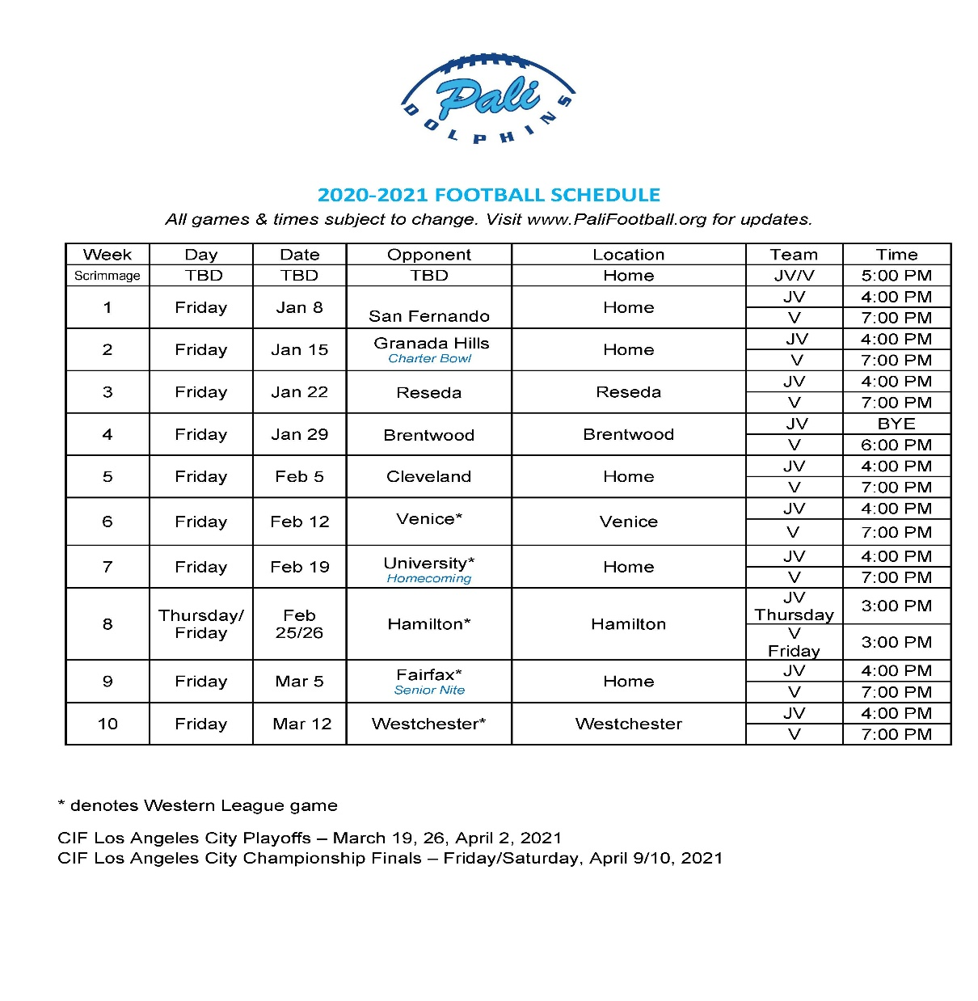

Slide 10
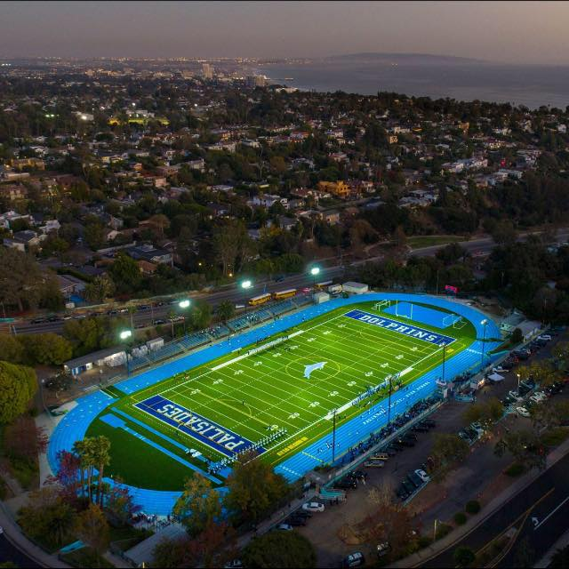
THANK YOU
Pali QB Club:
President: Lisa Manheim VP: Jill Calcaterra Secretary: Jewlz Fahn CFO: Nina Knierim
Fundraising:
Heather Bell: heather.bell@theagencyre.com Ken Ehrlich: kehrlich@elkinskalt.com

